Slide 1
Effective Job Coaching
FROM THE
EMPLOYERS PERSPECTIVE
Elyse Forbush
Senior Director of Business Development
JVS Boston
MA-APSE Board Secretary

Slide 2
About me
My name is Elyse Forbush and I am the Senior Director of Business Development at JVS Boston. Previously, I was the Director of Nutrition and Food Services for Spaulding Rehabilitation Hospital in Charlestown. I graduated from Johnson & Wales University with a degree in Hospitality Management and a concentration in Sociology.
HIRING STATS SINCE 2015
47 adults with disabilities hired into the food service department
43% retention
27% of overall department
First hire in 2016 still employed at Spaulding today
JOBLAB AT SPAULDING CAMBRIDGE
Mock tray line
Shipping/receiving space
Patient room and office to mimic
housekeeping responsibilities
Silverware wrapping station
Managing a budget

Slide 3
5 Points of Job Coaching
COMMUNICATION & COACHING
COACHING DURING AN INTERVIEW
COACHING DURING ONBOARDING
COACHING ON SITE
COACHING AFTER WORK

Slide 4
Communication & Coaching
Helping Employers Understand your Role
Communicate your role
What are the expectations of your job?
Communicate your plan
Why are you onsite and for how long?
Ask the employer their expectations for you
How can you help support them?
Follow up & follow through

Slide 5
Coaching During an Interview
Prep
Practice
Encourage
Effective ways to showcase their skills
Using full sentences & appropriate responses
Independent Interviews
Self Advocacy
&
Appropriate Questions

Slide 6
Resume Example
Focus on:
Abilities!
How to demonstrate abilities
Critical skills for the position

Slide 7
Interactive Interview
Simple Instructions:
Remove items
Find items listed on the ticket
and put them on the tray
Simple Instructions:
Plug in & Push Vacuum
Remove boxes from shelf
Put boxes on cart and push cart
to back table

Slide 8
Coaching During Onboarding
Listen In
Be Responsive
Gather
Ask if it’s ok to listen in during orientation and/or HR conversations
Encourage and guide your client through onboarding emails
Necessary documents

Slide 9
Transition the Family
Assist with communication about their child’s new job
Support their questions
Reinforce that this is not a program, but a real job
Set Boundaries

Slide 10
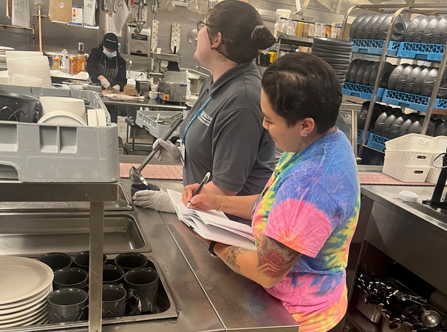
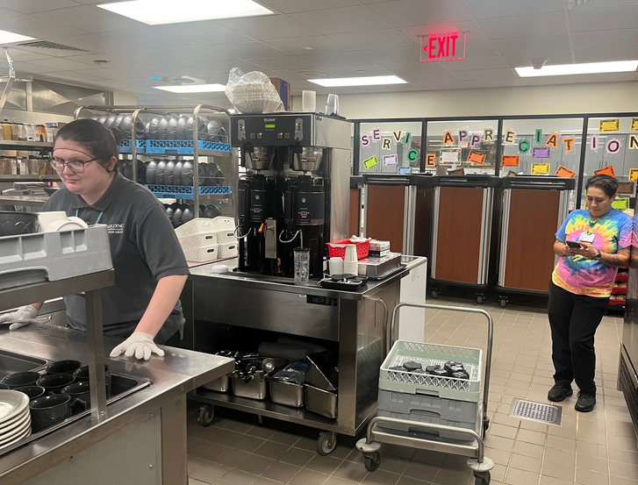
Coaching On Site
DO
Check in with the supervisor/manager regarding areas of improvement
Ask how you can best support
DO
Work & observe beside your client
Understand their responsibilities and job description
DO
DON’T
Ask questions FOR your client
Overstep!
Discipline other coworkers
Undermined what is being asked of your client
DON’T
DON’T
Show up just to show up
Be on your phone
Be far away from where your client is working

Slide 11
Coaching After Work
Follow up
Areas of Improvement
Communicate!
Feedback from Managers & Supervisors
Plan to Practice
Communicate!
Your plan for after work

Slide 12
JobLab

Slide 13
Tell Me
Tell me and I will Forget
Teach me and I will Remember
Involve me and I will Learn
-Benjamin Franklin

Slide 14
Q & A
Thank you

